Slide 1
Charlottesville Redevelopment and Housing Authority
PARKING & TOWING POLICY

Slide 2
The Parking & Towing Policy
This Policy applies to all CRHA properties with resident parking areas.
The Executive Director (or any designee(s)) is authorized to enforce this Policy.

Slide 3
Resident Vehicle Registration
All resident owned motorized vehicles such as automobiles, motorcycles, mopeds, etc. must be registered with CRHA
CRHA Rental Office is located at
500 South First Street Charlottesville, VA 22902.
As a condition of registration, resident shall provide the following information for each vehicle: make, model, color, and license plate number.

Slide 4
The vehicle must be registered to a resident or household member.
The parking permit must be displayed on the rear back driver side of the windshield.
The Parking Permit will display the last four digits of the registered vehicle’s license plate number.
Parking permits may not be transferred between residents or vehicles; each resident owned vehicle must have a separate parking pass.

Slide 5
It is the responsibility of all residents to ensure that the resident’s vehicle(s) is registered with CRHA
It is the responsibility of all residents to ensure that the parking permit is properly displayed at all times, in accordance with this Policy.

Slide 6
Only (1) permit will be issued for each vehicle in the household that has been properly registered.
No more than (4) Parking Permits will be issued per household.
If the household has more than (4) registered vehicles a Guest passes must be used.

Slide 7
PLACEMENT OF RESIDENT VEHICLE PARKING PASS
PLACED IN THE BACK REAR WINDOW ON THE LEFT SIDE

Slide 8
GUEST/VISITOR PARKING PASS
CRHA shall issue to residents two guest passes per unit.
Residents are responsible for distributing and collecting of guest passes from their guest.
Guest passes shall be hung from the rearview mirror of the guest vehicle at all times while parked on CRHA property.
Vehicles driven by residents but not registered to the resident must display a guest pass.
Guest passes will display the unit address in which the pass is issued.

Slide 9
From time to time, residents and resident organizations may wish to host guests for specific, time limited events (family gatherings; etc.). In these situations, the resident;
may request temporary parking passes for such events.
The request must be made no later than 48 hours prior to the event and must include:
Number of guests
Time, date and location of event
The name, address and telephone number of the resident hosting the event

Slide 10
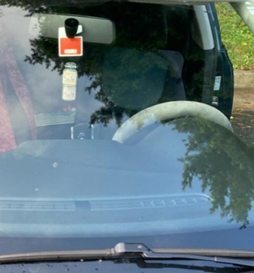
Placement of the Guest/Visitor Vehicle Parking Pass
HANG BEHIND THE REARVIEW MIRROR

Slide 11
TOWING
Tommy Shull’s Wrecker Service, the Charlottesville Police Department, CRHA Security and CRHA Staff have the authority to tow vehicles that are improperly parked.
Any vehicle parking on CRHA property not properly displaying a valid resident registered parking permit or guest pass shall be towed without warning at the owner’s expense.

Slide 12
The following exception to the towing policy:
government, law enforcement and emergency vehicles (excluding buses; multi-axle vehicles)
marked pick-up, delivery and administrative vehicles belonging to agencies and businesses in the process of providing goods or services to residents including social service and home health care provide
moving vehicles in the process of being used for resident move-in or move-out purpose

Slide 13
9am to 8pm, Monday through Friday (“business hours”), holidays excluded, vehicle towing may only be initiated at the direction of CRHA staff. During non-business hours, CRHA authorizes the towing contractor to conduct vehicle towing activities when there is improperly parked or unregistered vehicles on CRHA properties.
CRHA is not responsible for any damage to vehicles removed from the property for violation of this parking policy.

Slide 14
Owners of towed vehicles must contact the towing company to arrange for vehicle recovery.
Towed vehicles will be subject to a towing fee of One Hundred Dollars ($100.00) and a daily storage fee of Twenty Dollars ($20.00) after the first 24 hours.
These fees are established by state law and are subject to change without notice.
CRHA has no control over the fees incurred.

Slide 15
Payment of fees is to be made to the towing company.
CRHA is not able to accept payments on behalf of, or otherwise arrange for the payment or waiver of any fees.
All payments and vehicle recovery arrangements are at the discretion of the towing company.

Slide 16
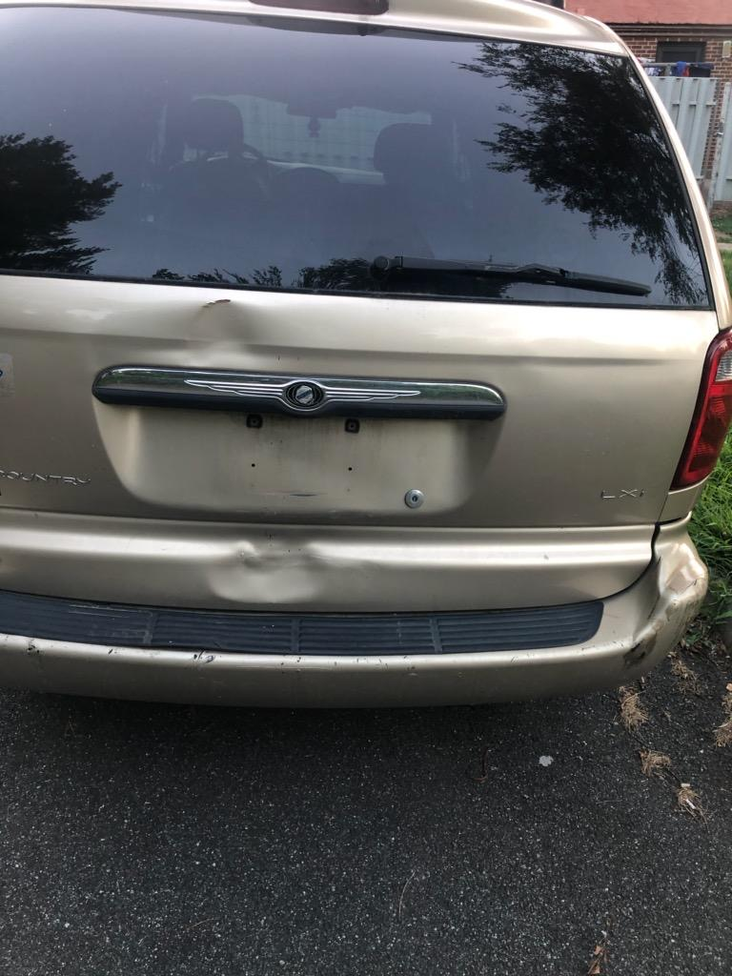
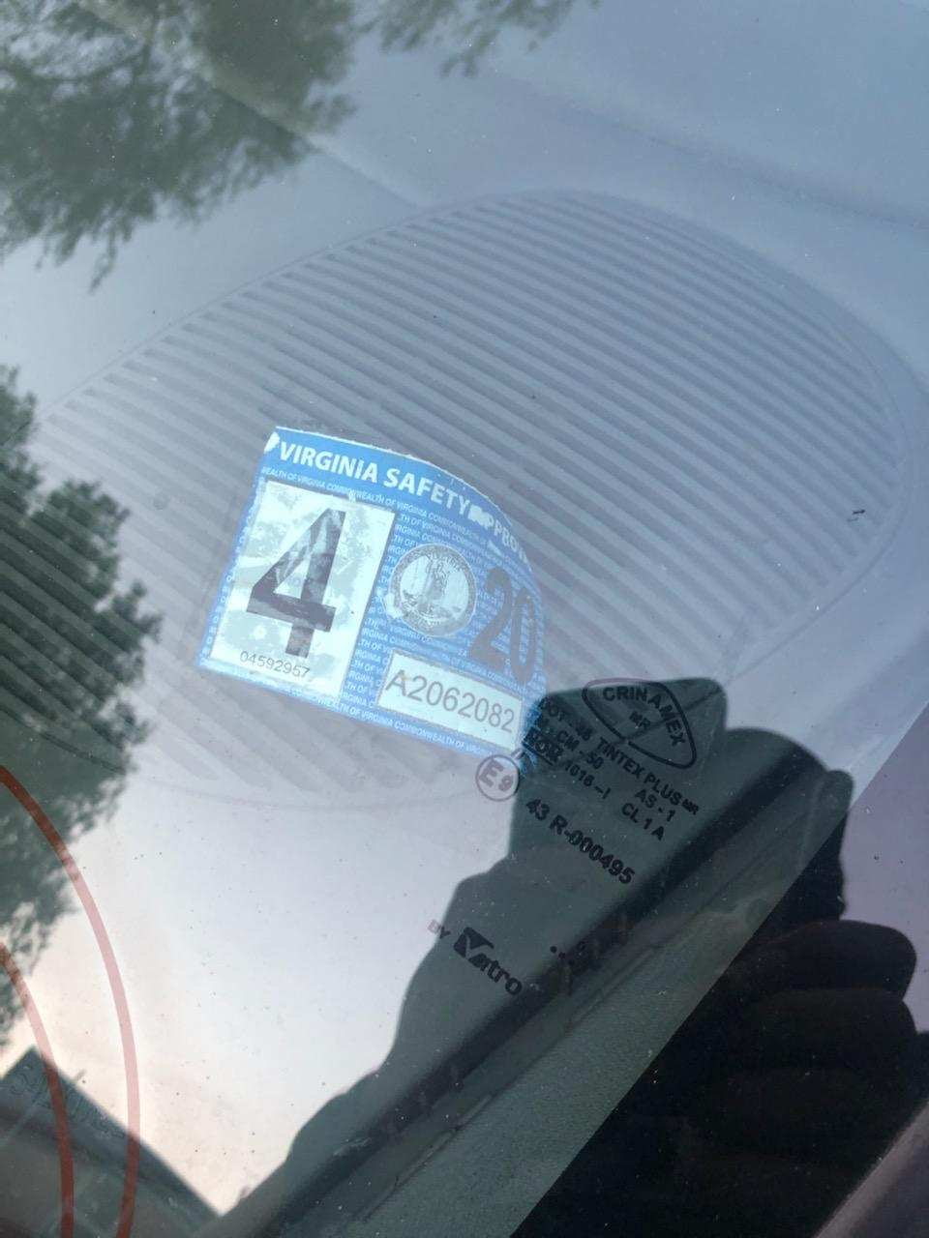
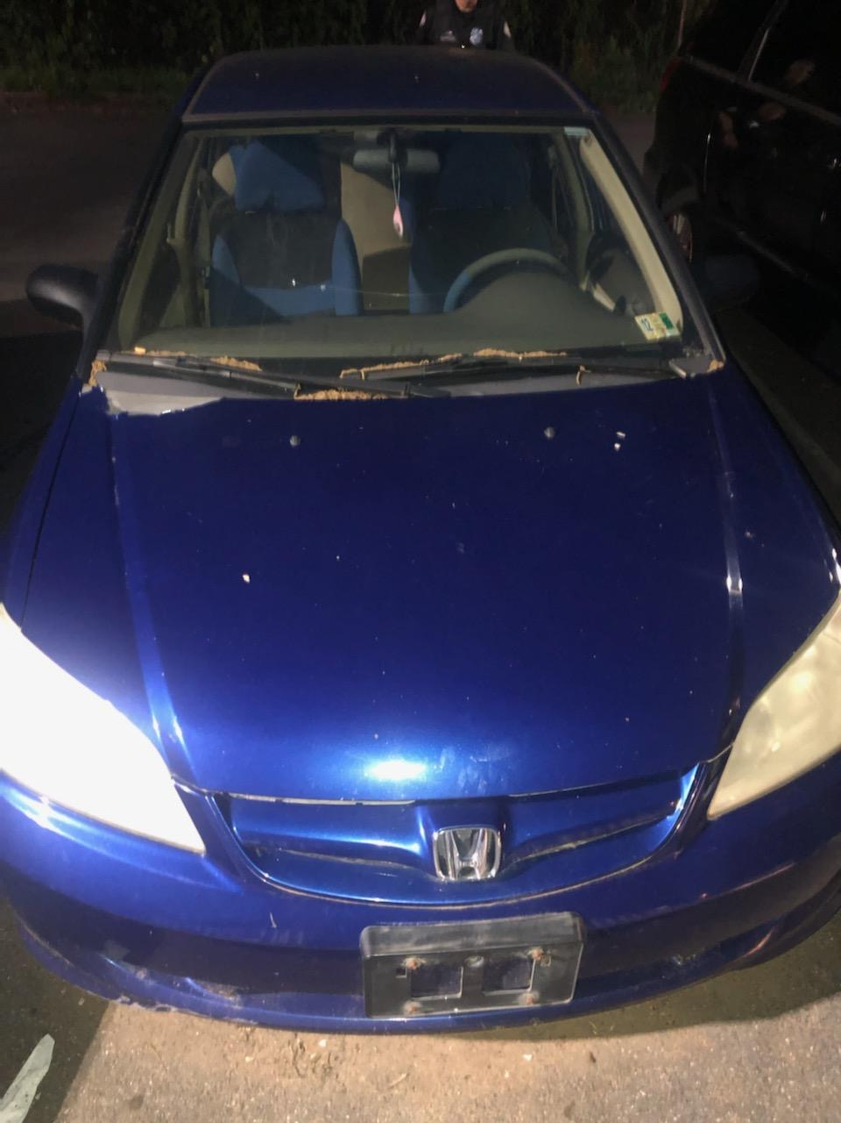
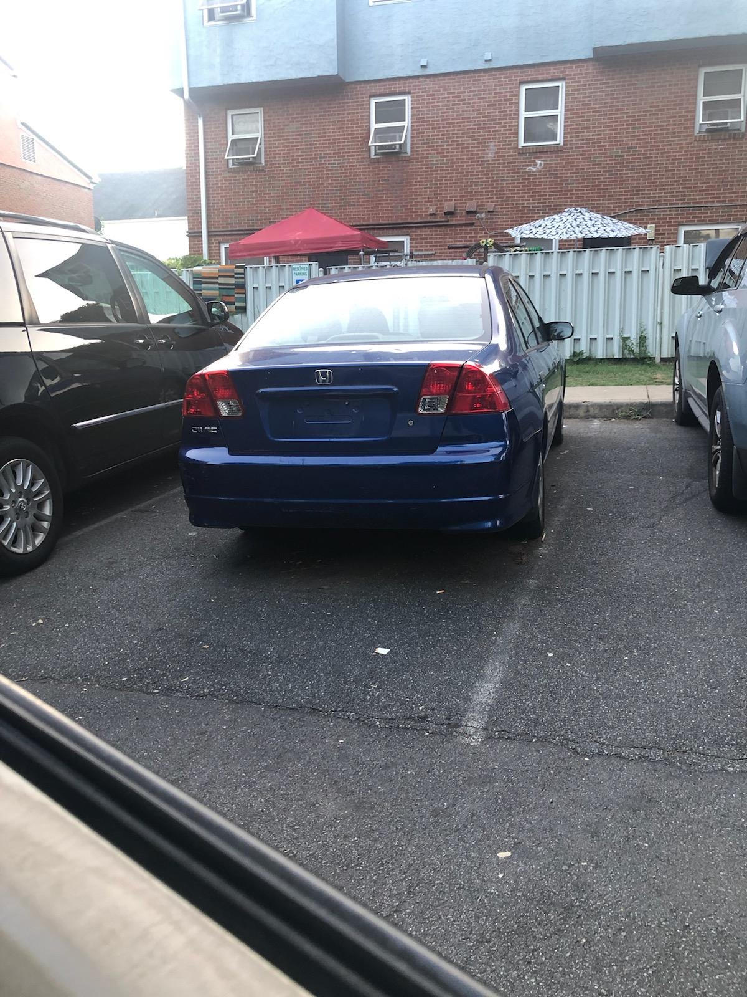
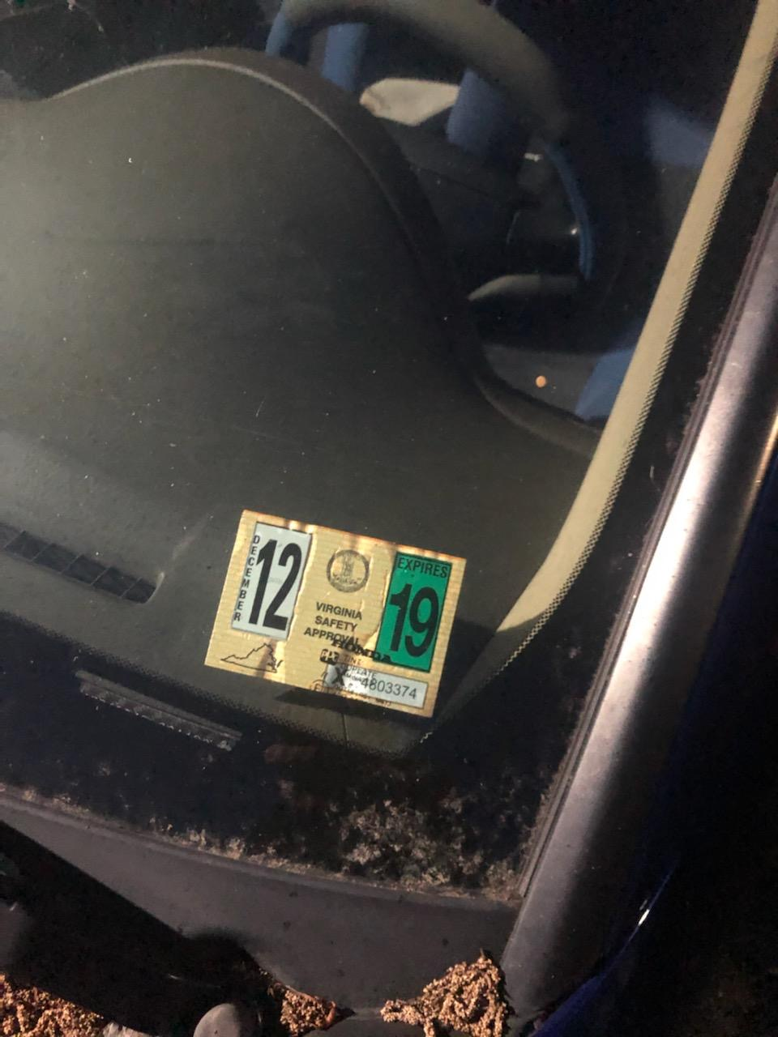
Examples of Why Vehicles Are Towed
Vehicle Has No Front License Plate
Vehicle Has No Rear License Plate
VA State Inspection Expired

Slide 17
PARKING PERMITTED IN DESIGNATED AREAS ONLY
Parking spaces are not assigned to specific apartments.
Any vehicle not parked within an individually marked, designated parking space shall be towed without warning at the owner’s expense, regardless of whether such vehicle displays a resident registered sticker or guest pass.
This includes any vehicle parked in a “no parking” marked area or a space designated for disabled individuals that does not display a valid disabled parking placard or license plate.
Parking of vehicles is not permitted in non-designated areas (common areas, front yards, handicapped spaces, yellow curbed lines, in front of dumpsters; etc.).

Slide 18
LOST RESIDENT PERMIT STICKER AND GUEST PASSES
The initial parking permit is free of charge.
Residents are responsible for promptly reporting lost or stolen resident parking permits and guest passes.
All resident parking permits and guest passes shall be returned upon the resident move-out.
CRHA will charge a $5.00 replacement fee for all lost, stolen, or damaged resident parking permits and guest passes.
Should you purchase a new vehicle, you must register the new vehicle and return the parking pass for the previous vehicle to the CRHA Rental Office.

Slide 19
INOPERABLE VEHICLES
No inoperable vehicle(s) may be parked in CRHA parking areas, per Charlottesville City Code Section 5-150.
For the purposes of this policy, an inoperable vehicle is considered a vehicle which is not in operating condition, does not display a valid license plate or inspection decal, or vehicles that have been left unattended for more than 5 days.

Slide 20
As a courtesy, CRHA shall provide one written warning (by sticker affixed to the vehicle or by hand delivered letter) at least 24 hours in advance of towing an inoperable vehicle that has a properly displayed valid resident parking permit or guest pass

Slide 21
Any inoperable vehicle properly displaying a valid resident parking permit or guest pass remaining upon CRHA property shall be towed without further warning at the owner’s expense.
All other inoperable vehicles not displaying a valid resident parking permit or guest pass will be towed immediately without warning at the owner’s expense.

Slide 22
MISCELLANEOUS
No parking permits will be issued unless all Lease and Recertification documents are signed by every household member over 18 years of age.
No Repairs (including washing of cars and changing oil) may be done to vehicles anywhere on CRHA property.
Any vehicle parked in a non-designated area, such as the grass, fire lanes, or in front of a dumpster will be towed at the owner’s expense without further notice. If a permit has been issued to that car, it may be revoked and all parking privileges suspended.

Slide 23
Commercial Vehicles, due to a resident’s place of employment, may obtain a parking permit. A letter from the resident’s employer stating the resident is required to keep the vehicle at their residence may be required.

Slide 24
Boats, trucks, campers, oversized vehicles, golf carts, four-wheelers, or any other recreational vehicles are not allowed to be parked on the premises.
Moving trucks or other vehicles are not allowed to park on the grass, sidewalks, or other landscaped areas.

Slide 25
CRHA has designated the following holidays as “no towing” days: Thanksgiving Day, Mother’s Day, Father’s Day, Easter, Christmas Eve, and Christmas Day, New Year’s Eve & New Year’s Day.

